Slide 1
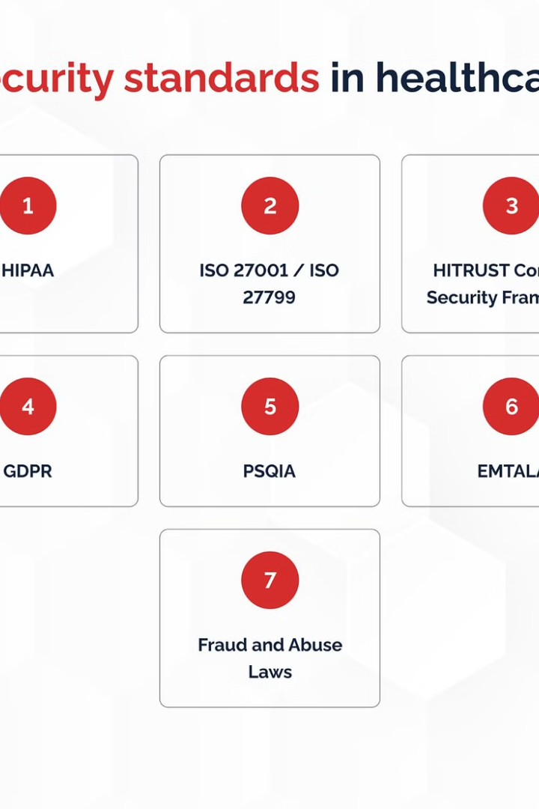
Ensuring Security and Compliance in Healthcare Big Data
Healthcare organizations handle sensitive patient data, making robust security and compliance critical for their big data infrastructure. Breaches can compromise privacy, harm patient trust, and result in steep penalties. Proactive measures are essential to safeguard this vital information.
by Tamizhselvan.V (192224029)
Ts

Slide 2
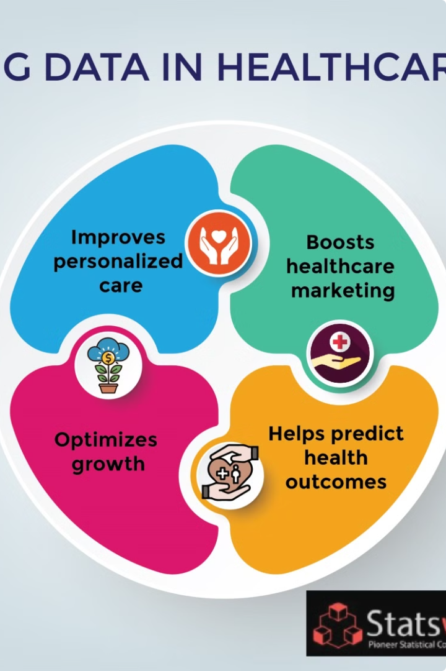
Overview of the Healthcare Organization's Big Data Infrastructure
The healthcare organization has built a state-of-the-art big data platform to process and analyze a vast amount of sensitive patient data. This infrastructure leverages cutting-edge technologies such as distributed data storage, scalable processing frameworks, and advanced analytics capabilities.
At the core of the system is a highly resilient and fault-tolerant data lake, which ingests data from various electronic health record systems, medical devices, and patient-generated sources. The data is then processed, transformed, and stored securely for downstream analytics and reporting.

Slide 3
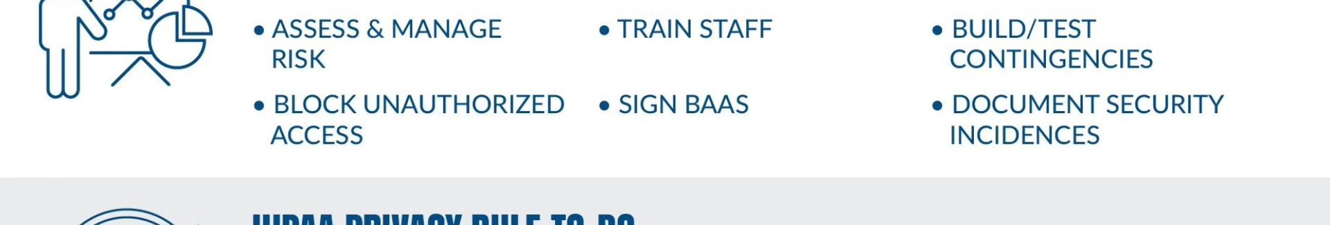
Regulatory Landscape and Compliance Requirements
HIPAA Compliance
GDPR Compliance
Other Regulations
The Health Insurance Portability and Accountability Act (HIPAA) sets strict standards for protecting the privacy and security of patient health information in the United States.
The European Union's General Data Protection Regulation (GDPR) governs the processing and protection of personal data, including sensitive healthcare data, for EU residents.
Healthcare organizations may also need to comply with various state and industry-specific regulations, such as data breach notification laws and security standards for electronic health records.

Slide 4
Data Security Best Practices for Sensitive Healthcare Data
1
Robust Access Controls
2
Comprehensive Encryption
Implement stringent access policies that restrict data access to only authorized personnel based on their roles and responsibilities.
Ensure all sensitive data is encrypted at rest and in transit using industry-standard encryption algorithms and key management practices.
3
Secure Data Lifecycle
4
Rigorous Monitoring
Establish secure protocols for data ingestion, processing, storage, and disposal to prevent unauthorized access or leakage.
Continuously monitor and audit data activities to detect and respond to any suspicious or anomalous behavior in a timely manner.

Slide 5

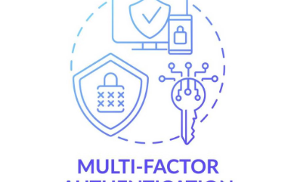
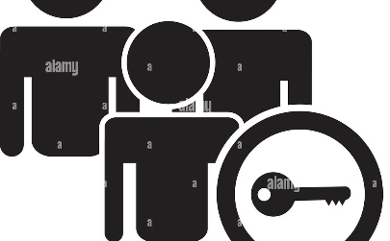
Access Control and Identity Management
Granular Access Controls
Robust Authentication
Periodic Access Reviews
Implement role-based access controls to ensure only authorized personnel can access sensitive healthcare data based on their job functions and responsibilities.
Require multifactor authentication, including strong passwords, biometrics, and secure tokens, to verify the identity of users accessing the big data infrastructure.
Regularly review and audit user access privileges to identify and revoke unnecessary or outdated permissions, maintaining tight control over data access.

Slide 6



Encryption and Data Protection Mechanisms
Data Encryption
Secure Key Management
Access Controls
Implement robust encryption techniques such as AES, RSA, or elliptic curve cryptography to protect sensitive healthcare data at rest and in transit.
Establish a comprehensive key management system to generate, distribute, and regularly rotate encryption keys to maintain the highest levels of data security.
Implement granular access controls and role-based permissions to ensure only authorized personnel can access sensitive data based on their specific needs.

Slide 7
Secure Data Ingestion, Processing, and Storage
Secure Data Ingestion
Secure Processing
Secure Storage
Compliance Alignment
Store sensitive healthcare data in encrypted data stores with strict access controls. Implement robust backup and disaster recovery procedures to safeguard data. Regularly audit storage systems to identify and address any security vulnerabilities.
Implement robust data ingestion pipelines with end-to-end encryption, authentication, and authorization mechanisms. Use secure protocols like HTTPS and leverage identity management systems to control access to sensitive data.
Ensure all data processing is performed in a secure computing environment. Leverage technologies like containerization, encryption, and secure enclaves to protect data during computation. Monitor processing activities for any anomalies or unauthorized access attempts.
Align all data ingestion, processing, and storage practices with relevant healthcare data regulations, such as HIPAA and GDPR. Maintain detailed audit trails and documentation to demonstrate compliance.

Slide 8



Monitoring, Auditing, and Incident Response
Vigilant Monitoring
Rigorous Auditing
Rapid Incident Response
Continuously monitor the big data infrastructure for suspicious activity, data breaches, and compliance violations using advanced security analytics.
Regularly audit data access, processing, and storage to ensure alignment with HIPAA, GDPR, and other regulatory requirements.
Establish a comprehensive incident response plan to quickly identify, contain, and remediate any security incidents or data breaches.

Slide 9
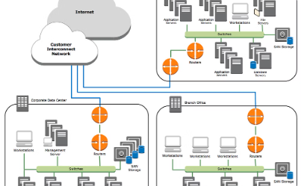
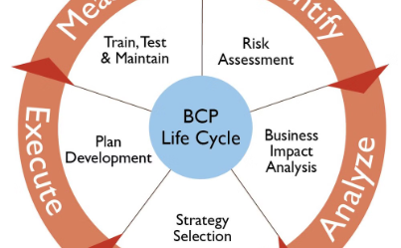
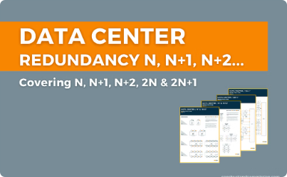
Disaster Recovery and Business Continuity Planning
Robust Backup and Recovery
Comprehensive BC Planning
Redundant Infrastructure
Implement comprehensive backup strategies to ensure the organization's critical data and systems can be rapidly restored in the event of a disaster or system failure.
Develop detailed business continuity plans that outline procedures for maintaining operations, minimizing downtime, and restoring services in a timely manner during disruptive events.
Leverage redundant data centers, failover mechanisms, and high availability architectures to provide fault tolerance and minimize single points of failure in the big data infrastructure.

Slide 10
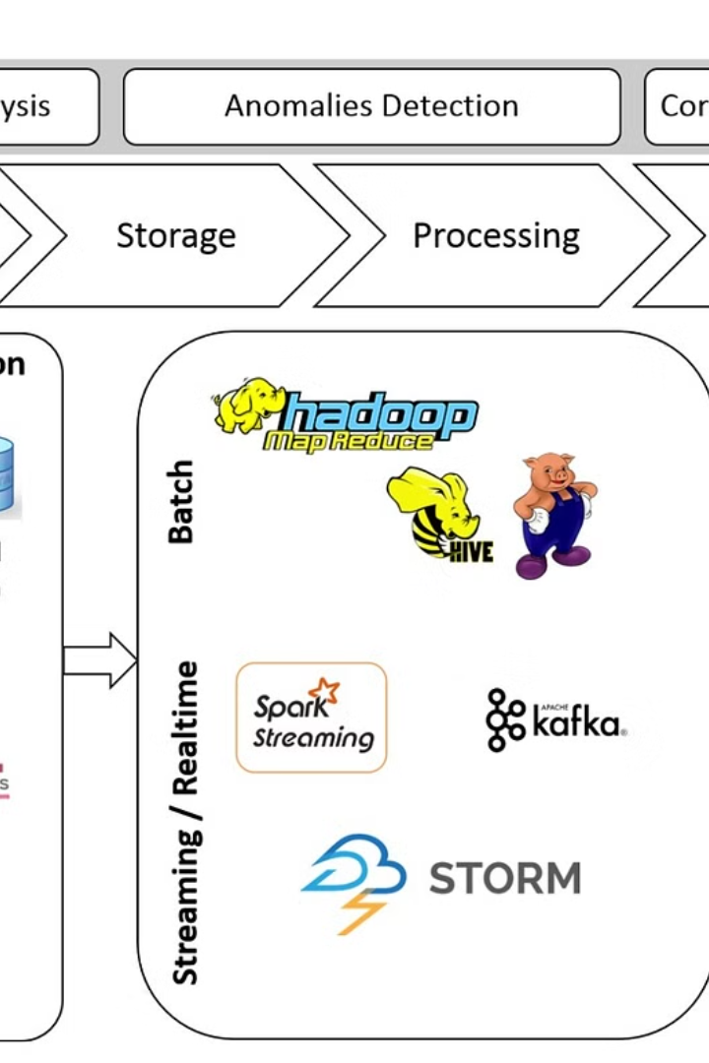
Strategies for Maintaining a Secure and Compliant Big Data Environment
Ensuring the long-term security and compliance of a healthcare organization's big data infrastructure requires a multi-faceted approach. This includes ongoing monitoring, risk assessment, employee training, and adaptability to evolving regulatory requirements and cybersecurity threats.

